Slide 1
Lesson 13 Differentiation and Integration of Exponential Functions
Interactive Seminar Slides
E114 – Mathematics for Engineering

Slide 2
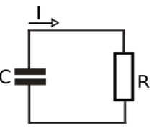
Scenario
When we connect a charged-up capacitor C with a resistor R, the current I(t) amperes t seconds after the switch is closed has the following equation:
where and is the charge separation.
Given R = 100 kΩ and C = 22 uF,
Determine the value of when the initial current is 40 A.
Show that the rate of decrease of the current is proportional to the instantaneous current.
Source:
https://en.wikipedia.org/wiki/RC_circuit

Slide 3
Scenario Definition Template
What do we know?
The capacitance C and resistance R are given
The equation of the current is given.
Exponential graph from A113 P07.
Negative exponential graph as capacitor is discharging in this circuit.
What do we not know?
How to find the rate of an exponential function?
What is an exponential function?
What do we need to find out?
Determine the value of when the initial current is 40 A.
Determine that the rate of decrease of the current and show that it is proportional to the instantaneous current.

Slide 4
Lesson Overview
S/N | Concepts | Slide Number
1 | Exponential Function | 5-10
2 | Differentiating of exponential functions | 11-15
3 | Integrating of exponential functions | 17
4 | Integration of | 18-21
5 | Definite Integrals | 22-25
6 | Applications of Exponential Functions (CL) | 26-28

Slide 5
Exponential Function
(Recap from A113 Problem 07) When a quantity exhibits a pattern of growth such that proportion in growth for every fixed time interval is the same, we can identify such a growth pattern as an exponential growth.
Examples of exponential functions are logistic (population growth) function, bacteria growth function, radioactive decay function etc.
Given the data in the table, how to determine the function y?
→ Quantity y grows exponentially with time.
Evidence: It doubles (same proportion) in every 5 days (fixed time interval)
t (Days) | y
0 | 10
5 | 20
10 | 40
15 | 80
20 | 160
[Example]
[Solution]

Slide 6
















Exponential Function
After identifying exponential change, we can now express $y$ in terms of $t$, in the form of
Re-writing the values of y to identify the pattern
Initial value
t (Days) | y
0 | 10
5 | 20
10 | 40
15 | 80
20 | 160
$$10×2^{\frac{0}{5}}$$
$$10×1$$
$$10×2^{0}$$
$$10×2^{\frac{5}{5}}$$
$$10×2$$
$$10×2^{1}$$
$$10×2^{\frac{10}{5}}$$
$$10×4$$
$$10×2^{2}$$
$$10×2^{\frac{15}{5}}$$
$$10×8$$
$$10×2^{3}$$
$$10×2^{\frac{20}{5}}$$
$10×1$6
$$10×2^{4}$$

Slide 7





Exponential Function
After identifying exponential change, we can now express y in terms of t, in the form of
Re-writing the values of y to identify the pattern
Initial value
Multiplier in each time interval
t (Days) | y
0 | 10
5 | 20
10 | 40
15 | 80
20 | 160
$$10×2^{\frac{0}{5}}$$
$$10×1$$
$$10×2^{0}$$
× 2
$$10×2^{\frac{5}{5}}$$
$$10×2$$
$$10×2^{1}$$
× 2
$$10×2^{\frac{10}{5}}$$
$$10×4$$
$$10×2^{2}$$
× 2
$$10×2^{\frac{15}{5}}$$
$$10×8$$
$$10×2^{3}$$
× 2
$$10×2^{\frac{20}{5}}$$
$10×1$6
$$10×2^{4}$$

Slide 8

Exponential Function
After identifying exponential change, we can now express y in terms of t, in the form of
Re-writing the values of $y$ to identify the pattern
Length of each time interval
Initial value
Multiplier in each time interval
t (Days) | y
0 | 10
5 | 20
10 | 40
15 | 80
20 | 160
$$10×2^{\frac{0}{5}}$$
Hence, for this example,
$$10×1$$
$$10×2^{0}$$
+ 5
$$10×2^{\frac{5}{5}}$$
$$10×2$$
$$10×2^{1}$$
+ 5
$$10×2^{\frac{10}{5}}$$
$$10×4$$
$$10×2^{2}$$
+ 5
$$10×2^{\frac{15}{5}}$$
$$10×8$$
$$10×2^{3}$$
+ 5
$$10×2^{\frac{20}{5}}$$
$10×1$6
$$10×2^{4}$$

Slide 9
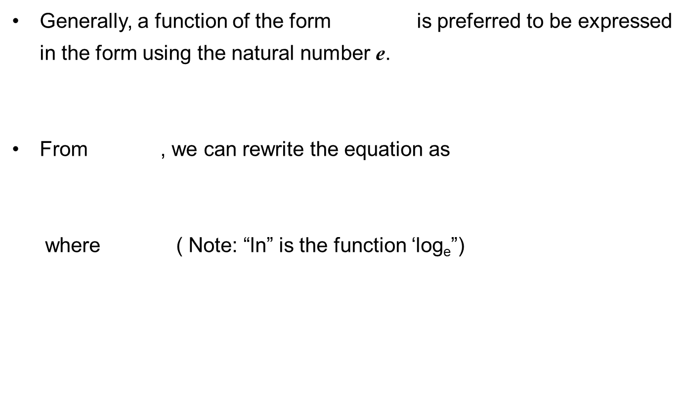
Exponential Function
Generally, a function of the form is preferred to be expressed in the form using the natural number e.
From , we can rewrite the equation as
where ( Note: “ln” is the function ‘log_{e}”)
[Example]

Slide 10

Practice (Think-Pair-Share)
Suppose the population of a certain type of micro-organism increases by 3 times its quantity in every 15 seconds. It starts with an initial population of 8 micro-organism.
Would you consider this population growth as an exponential growth?
What would be the population of the micro-organism after 1 minute?
Express population (y) in terms of time (t).
Express y in terms of t in the form .

Slide 11
Differentiating Exponential Functions
Exponential functions of the form, , where a, b and k are constants can be differentiated.
The result is given as:
Copy down function
Differentiate power
Multiply together

Slide 12
Differentiating Exponential Functions
[Example]
Copy down function
Differentiate power
Multiply together
[Example]

Slide 13
Practice (Think-Pair-Share)
Determine given that

Slide 14
Differentiating Exponential Functions
Exponential functions of the form, , where a is a constant can also be differentiated.
The result is given as:
Copy down function
Differentiate power
Multiply together
[Example]

Slide 15
BRAIN BREAK
Never do tomorrow what you can do today. Procrastination is the thief of time.
-- Charles Dickens

Slide 16
Integration of Exponential functions
Since , we have
where C is a constant.
Therefore, for exponential functions in the form, where k is a constant,

Slide 17
Integration of
Since
Therefore
Evaluate
[Example]

Slide 18
Integration of
Determine the equation of where y = 16
and x = 0.1
When y = 16 and x = 0.1,
therefore
[Example]
[Solution]
Correct?

Slide 19
Practice (Think-Pair-Share)
.
Determine the equation of where y = 12
when x = 0.2 .

Slide 20
Integration of with limits (Definite Integrals)
where C is a constant.
Since is integrated from x = g to x = g:
Hence can be written as

Slide 21
Integration of with limits (Definite Integrals)
Evaluate
[Example]
[Solution]

Slide 22
Practice (Think-Pair-Share)
Evaluate

Slide 23

Kahoot.it!

Slide 24
Kahoot.it!

Slide 25
Summary (CL)
Differentiation rules
Integration rules
Type of function
Algebraic
Trigonometric
Exponential
Type of function
Algebraic
Trigonometric
Exponential
where a, b, C, d, k and n are constants.

Slide 26
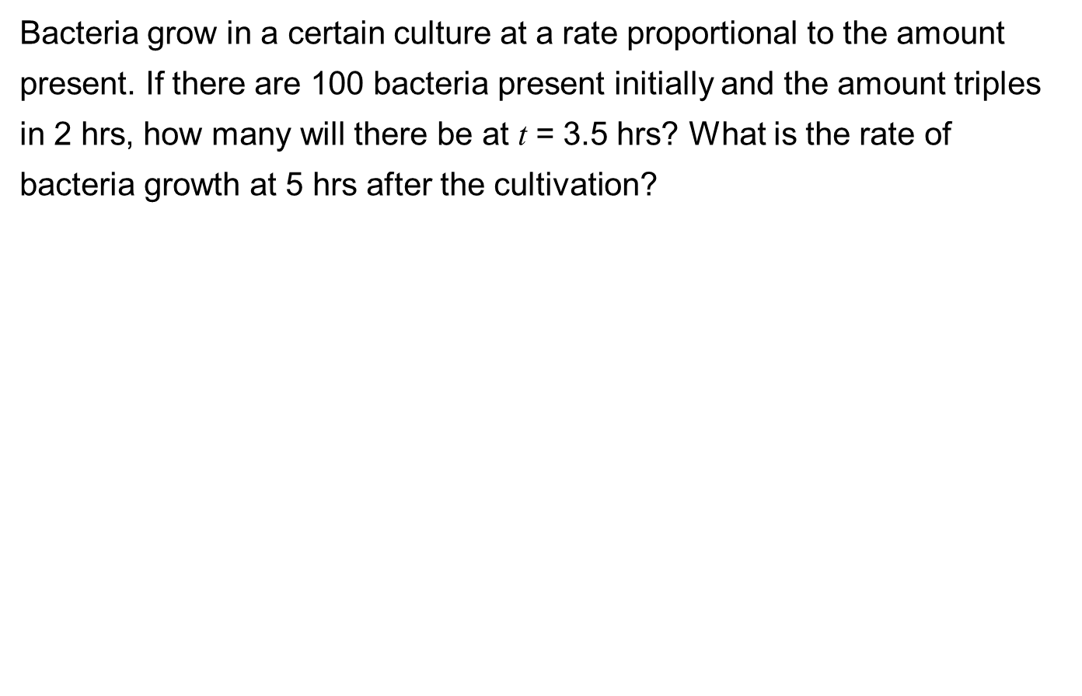
Test yourself (CL)
Bacteria grow in a certain culture at a rate proportional to the amount present. If there are 100 bacteria present initially and the amount triples in 2 hrs, how many will there be at t = 3.5 hrs? What is the rate of bacteria growth at 5 hrs after the cultivation?

Slide 27
Practice (Think-Pair-Share) (CL)
The rate of change of a certain radioactive element count is represented by the equation , where t is measured in hours. What is the change in the radioactive element count from 10 hours to 20 hours?

Slide 28
Applications of Exponential Functions (CL)
A radioactive material has a half-life of 800 years. What is the rate of decrease of the material after 50 years when it has 10 g initially?
The radioactive material decay follows an exponential function:
At t = 800 years , the amount of material left is half of the initial amount:
Alternatively, we can use the tabulation method to obtain the value of k.
[Example]
[Solution]

Slide 29















Applications of Exponential Functions (CL)
Rewriting the expression in the form of where ,
Rate of decay:
At t = 50 years
[Solution] Continued..
t (Years) | y
0 | 10.00
800 | 5.000
1600 | 2.500
2400 | 1.250
3200 | 0.625
$$10×1$$
$$10×{0.5}^{0}$$
$$10×{0.5}^{\frac{0}{800}}$$
Hence, for this example,
$$10×0.5$$
$$10×{0.5}^{1}$$
$$10×{0.5}^{\frac{800}{800}}$$
$$10×0.25$$
$$10×{0.5}^{2}$$
$$10×{0.5}^{\frac{1600}{800}}$$
$$10×0.125$$
$$10×{0.5}^{3}$$
$$10×{0.5}^{\frac{2400}{800}}$$
$$10×0.0625$$
$$10×{0.5}^{4}$$
$$10×{0.5}^{\frac{3200}{800}}$$

Slide 30
One-minute write
Instruction for lecturers: please copy the correct link and put it in the yellow box in the next slide for your IS class:
https://todaysmeet.com/LRE2-Day3
https://todaysmeet.com/LRE4-Day3
https://todaysmeet.com/LRW3-Day3
https://todaysmeet.com/LRW5-Day3
https://todaysmeet.com/LRE5-Day3
https://todaysmeet.com/LRE2-Day4
https://todaysmeet.com/LRE4-Day4
https://todaysmeet.com/LRW3-Day4
https://todaysmeet.com/LRW5-Day4
https://todaysmeet.com/LRE5-Day4
https://todaysmeet.com/LRE2-Day1
https://todaysmeet.com/LRE4-Day1
https://todaysmeet.com/LRW3-Day1
https://todaysmeet.com/LRW5-Day1
https://todaysmeet.com/LRE2-Day2
https://todaysmeet.com/LRE4-Day2
https://todaysmeet.com/LRW5-Day2
https://todaysmeet.com/LRW3-Day2

Slide 31
One-minute write
Instruction for lecturers: please copy the correct link and put it in the yellow box in the next slide for your IS class:
https://todaysmeet.com/LRE2-Day5
https://todaysmeet.com/LRE4-Day5
https://todaysmeet.com/LRW3-Day5
https://todaysmeet.com/LRW5-Day5

Slide 32
One-minute write
Please stop what you are doing and produce a written response to either of the following in only one minute:
Identify what is the key learning concepts from the seminar, or
What is the relationship between the amount of bacteria and its rate of growth?
Link:

Slide 33
Learning Objectives
Perform differentiation to obtain the rate of change of an algebraic function.
Compute the turning point of a differentiable function.
Compute the second derivative to determine the nature of the turning point(s) of a function.
Illustrate that integration is the reverse of differentiation.
Perform integration to obtain a non-definite integral.
Compute the constant term of a non-definite integral.

Slide 34
Learning Objectives
Perform integration to obtain a definite integral.
Compute the quantity accumulated with integration using the rate of change function.
Perform differentiation and integration of an exponential function.
Model and solve real-world problems involving differentiation and integration of exponential functions (e.g. population growth)
Interpret the results obtained from differentiation and integration of the given functions. (i.e. algebraic, exponential, trigonometric or any combinations)

